Slide 1
5 Microbial Biotechnology
I. Commercial Production of Microorganisms
A. Industrial Fermenters
B. Single-Cell Protein
II. Food Biotechnology
III. Products from Microorganisms
A. Metabolites
B. Enzymes
C. Antibiotics
D. Fuels
E. Biopolymers
F. Cause for Concern? Biotechnologies and Developing Countries
IV. Bioconversions
A. Use of Immobilized Cells
B. Biotech Revolution: Microbial Cell-Surface Display
V. Microorganisms and Agriculture
A. Ice-Nucleating Bacteria
B. Microbial Pesticides
1. Bacillus thuringiensis
2. Baculoviruses
VI. Bioremediation
A. Oil Spills B. Wastewater Treatment
C. Chemical Degradation D. Heavy Metals
VII. Oil and Mineral Recovery
A. Oil Recovery
B. Metal Extraction
C. Future of Bioremediation
VIII. Microorganisms and the Future

Slide 2
Commercial Production of Microorganisms
A. Commercial fermentation is performed in two ways:
1. Any process that produces bacteria and fungi as the end product.
2. Biotransformation, which is transforming a compound added to the fermentation medium into a commercially valuable compound.
Most fermentations require several things:
a) Sterilization of the fermentation vessel and associated equipment.
b) Preparation and sterilization of the culture medium.
c) Preparation of a pure cell culture for inoculation of the medium in the fermentation
vessel.
d) Cell growth and synthesis of the desired product under a specific set of conditions.
e) Product extraction and purification, or cell collection.
f) Disposal of expended medium and cells, and the cleaning of the bioreactor and equipment.

Slide 3
B. Industrial Fermenters
1. Also called “bioreactors,” these are sterile machines that provide proper conditions for cell
growth, as well as adequate conditions for extraction of products.
2. Different kinds of fermenters are available, depending on the application:
a) Stirred tank reactor—most common, relies on an agitator to circulate oxygen.
b) Airlift fermenter—supplies oxygen to the culture through an intake valve at the bottom of the culture vessel.
3. Products and cells are collected in two ways:
a) Continuous fermentation—nutrients are fed into the fermenter while an equal volume of products, cells, and medium are collected. Allows continuous culture growth to be maintained for long periods of time.
b) Batch culturing—cells, products, and medium are collected after fermentation is completed. Cells and liquid are separated, and the product of interest is extracted from the liquid or the cells.

Slide 4
Solid substrate fermentation:
1. Has been investigated for the production of things such as protein-enriched animal feed,
bioremediation substances, biopesticides, and single-cell protein.
2. Microorganisms are grown on solid substrates and not submerged in liquid. Moisture is absorbed onto the substrate.
3. Most microorganisms cannot grow rapidly enough or to a large enough amount to produce enough product.
4. Best used in the production of enzymes and secondary metabolites.
D. Ultrasound (sonication) is being examined to possibly increase production of cells within a bioreactor.

Slide 5
Single-Cell Protein (SCP)
1. Microbes have been used as food and food supplements for thousand of years.
2. SCP is generated when a monoculture of algal, bacterial, or fungal cells (usually have a protein content of 70%-80% of its dry weight) are grown in large volumes for use as human or livestock feed supplements.
3. High in minerals, vitamins, carbohydrates, lipids, and essential amino acids.
4. Produced using inexpensive substrates to supply nitrogen and carbon, such as methanol and waste from cheese production.
5. The cyanobacterium Spirulina is also used for SCP, and only needs water, a nitrogen source, minerals, and sunlight.
6. SCP may be produced in the future using wastes or industrial by-products, but sometimes also contains potentially toxic compounds (such as hepatotoxins produced cyanobacteria; heavy metals).

Slide 6
Food Biotechnology
A. Biotechnology has been used to produce foods and beverages for over 8000 years.
B. Microorganisms are a large part of the fermentation process, and the biochemical processes remain the same as in ancient times.
C. Some ways that the food industry improves food quality and production are:
1. More environmentally friendly manufacturing processes.
2. Better waste treatment.
3. Better assessment of food safety during production and processing.
4. The use of natural flavors and colors.
5. The use of new enzymes and emulsifiers.
6. Improved starter cultures for fermentation and the improvement of raw materials.

Slide 7
D. Some other ways that scientists are working on improving food-related fermentation:
1. Developing virus-resistant strains of bacteria.
2. Using bacteria that produce chemicals that kill contaminating bacteria.
3. Using microorganisms as sources of food additives, such as in the production of vitamins and amino acid supplements.
4. Microbial enzymes produced through recombinant DNA technology, such as rennin, which is used in the production of cheese.
E. Food safety is a growing concern:
1. New methods of food processing and treatment are being explored (irradiation has been debated).
2. Diagnostic methods are being used to more quickly detect microorganisms that may spoil food, such as those using PCR and monoclonal antibodies
(i) detection of fungi growing on peanuts and producing aflatoxin, a powerful toxin.
(ii) Potent bacteria such as E. coli 0157:H7, Clostridium botulinum, Listeria, and Salmonella.

Slide 8
III. Products From Microorganisms
A. Fermentation yields a large amount of commercially available compounds, such as flavorings, nutrients, and colorings for many foods. Microorganisms can also produce pharmaceutically active compounds such as antiinflammatory agents, antidepressants, anticoagulants, and coronary vasodilators. Also, important therapeutic chemicals, such as interferons & interleukins for cancer treatment, insulin or growth factor VIII (Fig 5.2).
B. Metabolites
1. Two types of metabolites are produced by microorganisms (Table 5.2):
a) Primary metabolites:
(1) Made during the organism’s growth phase.
(2) Essential to an organism’s metabolism and can be intermediate metabolites or end products.
b) Secondary metabolites:
(1) Not essential to cell function or growth and are usually made late in the organism’s growth cycle.
(2) Usually derived from primary metabolites or intermediates of primary metabolites.
(3) Most likely give the organism an advantage over competitors.

Slide 9
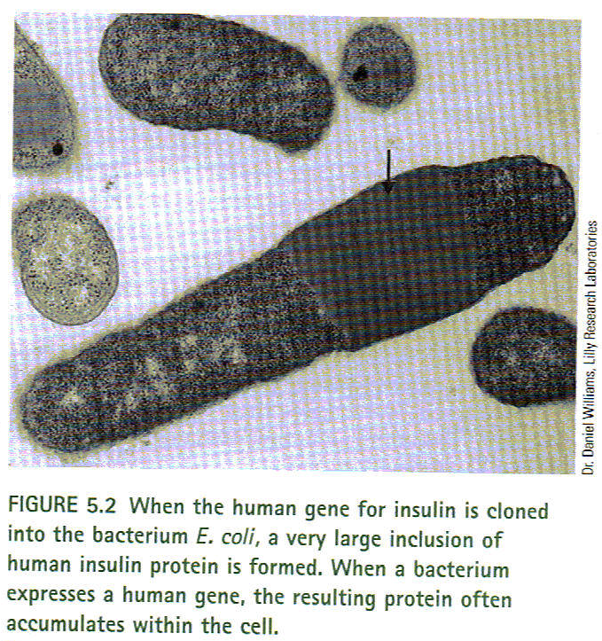

Slide 10
Enzymes
1. Isolated enzymes have applications in food, cosmetics, pharmaceuticals, and in the production of industrial chemicals and detergents (Table 5.3).
2. Enzymes are often used to convert substrates into products. High fructose corn syrup is an example, and is made by processing corn with three enzymes obtained from bacteria and fungi. Fructose has replaced sucrose as the major sweetener in the USA.
3. Recombinant DNA technology can allow us to take genes coding for enzymes and move those genes into yeast cells or bacteria like E. coli, so that potentially harmful bacteria do
not need to be used.
4. New enzymes are being discovered and researched for potentially new uses.

Slide 11
Antibiotics
1. Small antimicrobial metabolites produced by G+ & G- bacteria as well as fungi (Table 1.3).
2. In 1929, Alexander Fleming discovered penicillin was the first antibiotic discovered in the laboratory (used in WWII). Today, antibiotics are made by microbial fermentation.
3. Act to kill bacteria in three ways:
a) Disrupting the plasma membrane of microbes.
b) Inhibiting cell wall synthesis.
c) Inhibiting synthesis of metabolites such as proteins, nucleic acids, or folic acid.
4. Because of the increased numbers of antibiotic resistant bacteria, new ways to identify new antibiotics:
a) Screen secondary metabolites for antimicrobial activity.
b) Feeding unusual substrates and substrate analogs that can be used in antibiotic
synthetic pathways, with the example of beta-lactam antibiotics.\
c) Screening synthetic chemical libraries for compounds with antimicrobial activity.
d) Recombinant DNA technology can produce new antibiotics that are different in structure from the original antibiotic by manipulating genes and combining genes from different biosynthetic pathways to create new antibiotics.
e) Feed unusual substrates to a microorganism that contains a pathway from another organism, using existing pathways to produce new chemicals.

Slide 12
Fuels
1. The Earth contains finite amounts of natural fuels, and all produce pollution when burned.
2. Possible new fuels that could be used are:
a) Methane—a natural gas produced by anaerobic bacteria in swamps and landfills, it is inexpensive to culture such bacteria as it uses wastes as nutrients for growth. Burning methane produces carbon dioxide and water .
b) Hydrogen—produces water and energy upon combustion. Obstacles for using H include:
(i) it’s extremely combustible and prone to explosions.
(ii) high cost of extraction.
Bacteria such as those in the genus Clostridium and the alga Chlorella are possibilities because they produce large amounts of hydrogen for long periods of time.

Slide 13
Biopolymers
1. Most plastics are made from petroleum products and are heavy polluters because they are not biodegradable and end up in landfills, shores, or in the ocean.
2. So-called biodegradable or photodegradable plastics require ultraviolet light, oxygen, and other elements to slowly degrade them. However, there is no truly biodegradable plastic. Plastics cannot be burned because they produce harmful chemicals that are released into the air.
3. Bioplastics that are readily broken down by natural elements and microorganisms are a possibility:
a) Chemicals such as alkene oxides can be produced by microorganisms.
b) Microorganisms can produce polymers in the poly(β-hydroxyalkanoate), or PHA family, which are used for energy and to store carbon atoms.
c) Most common PHA is poly(β-hydroxybutyrate), or PHB, which can lead to the production of polyesters, and replaces petrochemical-based methods.
(1) Polymers of PHB have been used to create plastics that are similar to polypropylene.
(2) Recombinant DNA technology can be used to transfer genes involved in biopolymer synthesis to microorganisms (Fig 5.3)
d) Production of PHA and PHB has been researched, using sugarcane or corn as starting materials as well as yielding important nutrients.
e) PHA polymers can have many important applications:
(1) Carriers for fertilizers, insecticides, herbicides, and fungicides.
(2) In surgery such as sutures, pins, and staples.
(3) Artificial blood vessels.
(4) Bone replacements.
(5) Capsules for pharmaceuticals.
f) Other polymers include spider silk and adhesives from barnacles.
4. Rubber is also an important polymer:
a) Provides the raw material for more than 40,000 products.
b) Used in many different places because of its properties.
c) Current natural source is the Brazilian rubber tree, it cannot be readily synthesized, and the tree can only grow in limited places. Alternative plant sources such as crop plants can possibly be genetically engineered to produce rubber without using the rubber tree.

Slide 14
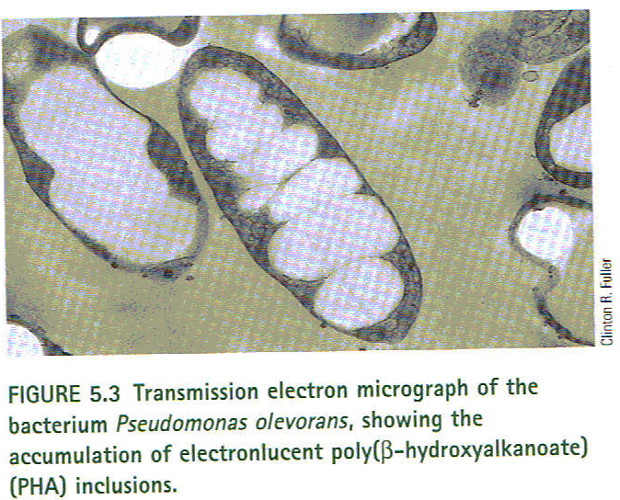

Slide 15
Cause for Concern? Biotechnologies and Developing Countries
What do you think?

Slide 16
Bioconversions
A. Occur when microorganisms modify a compound to a structurally related compound, sometimes with substrates not usually present in the environment.
B. Useful when a multistep chemical synthesis is more expensive or inefficient in the laboratory.
C. Bioconversions can produce chemicals such as the steroid prednisone. Laboratory synthesis can take thirty-seven steps, while bioconversions lower the steps to eleven.
D. Bioconversions can also produce vitamin C and amino acids.
E. Recombinant DNA technology may possibly be used to give microorganisms the enzymatic steps in the process.
F. Use of Immobilized Cells.
1. A preferred alternative to fermentation in the synthesis of compounds.
2. Cells are immobilized by chemical cross-linking or a matrix like agar, causing the cells to be concentrated and increase the amount of product.
3. Isolation of products is also easier and may increase biotransformation efficiency.
4. However, the process may cause undesirable chemical reactions that can alter the desired product.

Slide 17
Biotech Revolution: Microbial Cell-Surface Display (Figure 5.4)
1. New technology in which foreign proteins are displayed on the surface of microbial or yeast cells by anchoring them to cell-surface proteins.
2. The protein to be displayed is called the “passenger protein,” and the anchoring protein is called the “carrier protein.”
3. May be applied to:
a) Live vaccine development by exposing antigens on weakened bacteria.
b) Antibody production by expressing surface antigens to the immune system.
c) Bioadsorbents to remove hazardous chemicals and heavy metals.
d) Bioconversions using whole-cell biocatalysts with anchored, immobilized enzymes.
e) Signal-sensitive receptors or components for diagnostic applications in medicine or to monitor substances in the environment.

Slide 18
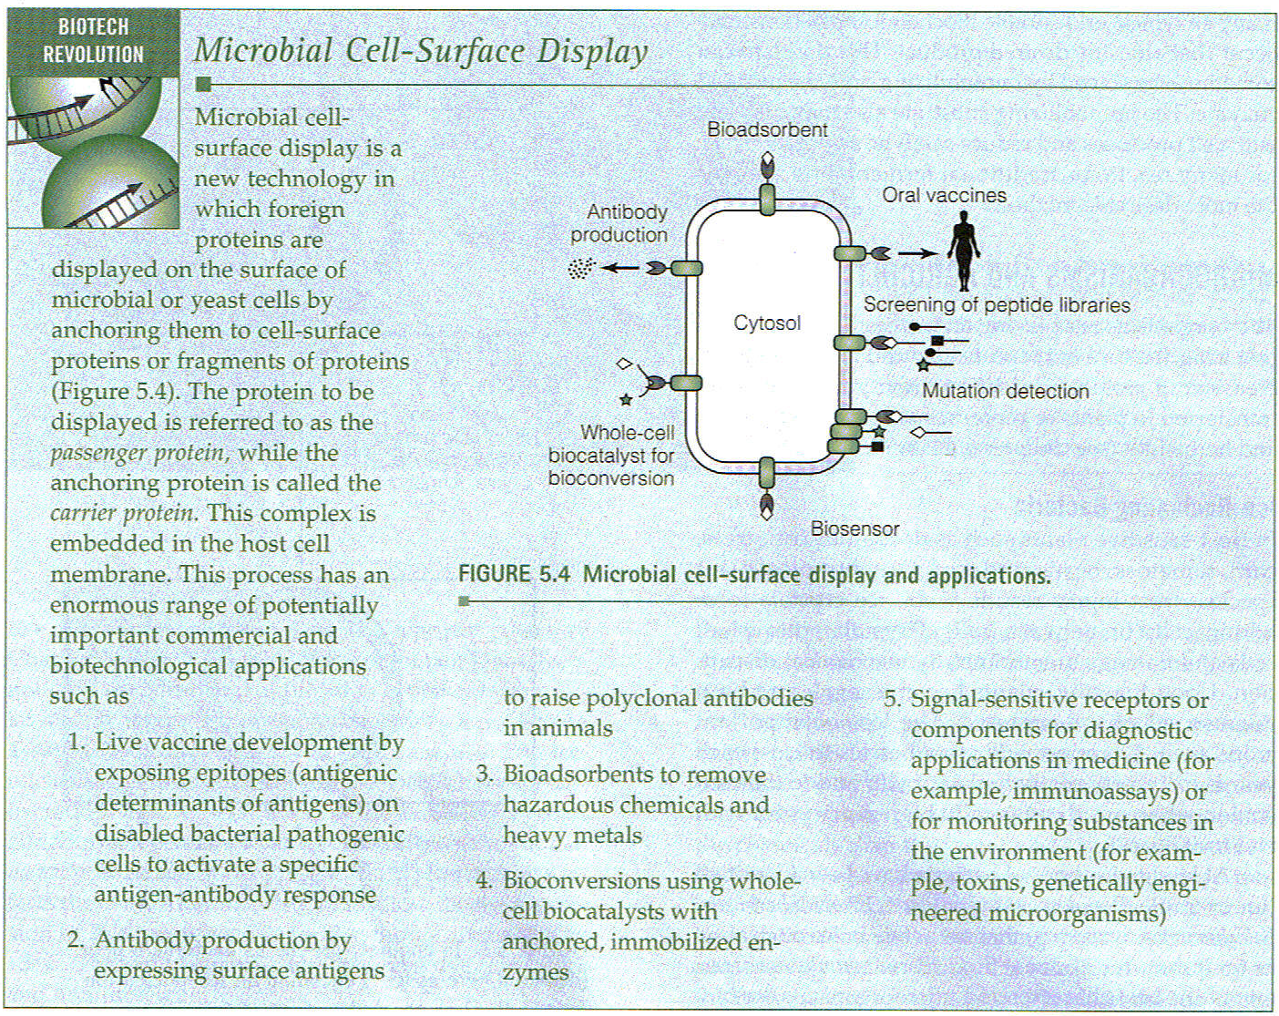

Slide 19
Microorganisms and Agriculture
Ice-Nucleating Bacteria.
1. Frost injury can result when ice crystals form in cells or between cells, rupturing cells and causing plants to be limp and soggy.
2. At least 10 species of bacteria have been found to promote crystal formation at temperatures above 50C, including Pseudomonas syringae.
3. P. syringae has had its ice-forming gene (called “Ina”) deleted and the modified bacteria was tested on strawberry and tomato plants in 1987
(Figure 5.5 &5.6).
4. In 1992, Frost Technologies registered with the EPA a mixture of two species of “ice-minus” bacteria under the trade name Frostban B, but was not able to complete the process due to the high cost of registration and testing.
5. Applications of ice-nucleation technology could include snowmaking, freeze- concentration to preserve flavors, and using the ice-nucleating gene as a reporter.

Slide 20
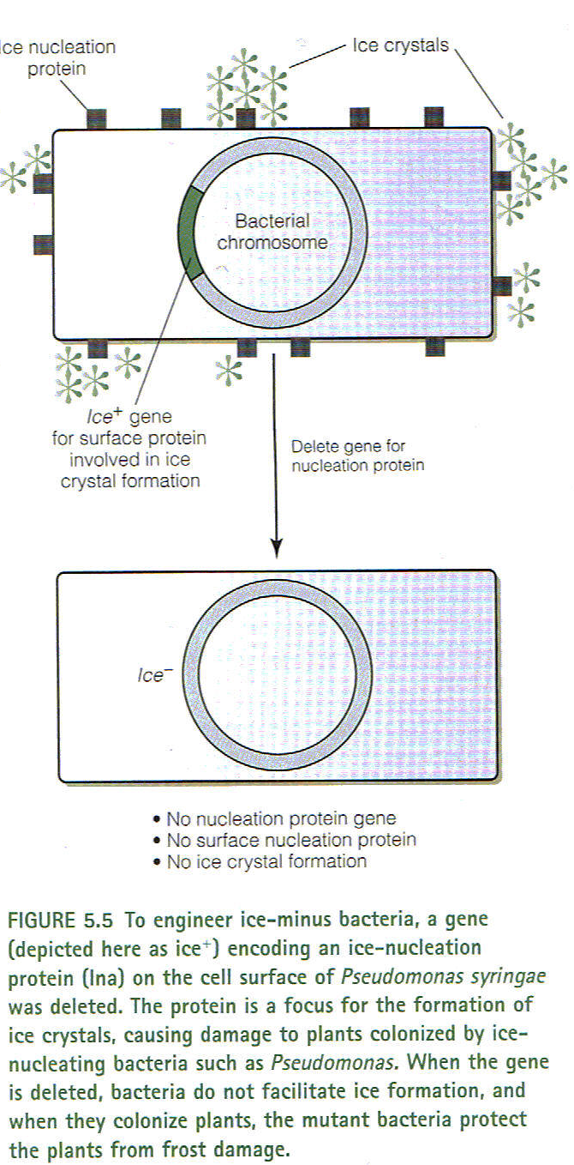

Slide 21
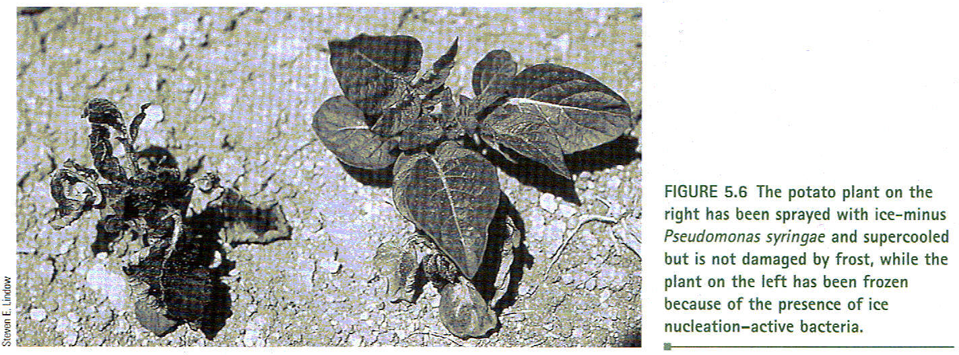

Slide 22
Microbial Pesticides
1. Chemical pesticides such as DDT have been used since the 1940s to control insect
populations on crops. DDT was used in large amounts and is harmful to the environment, as well as the development of resistance to DDT.
2. To provide alternatives to DDT, scientists have researched using microorganisms and insect viruses as biodegradable insecticides that are insect-specific.
3. Microbial and viral pesticides are proteins that rapidly break down naturally, and the genes are being researched to possibly place into hosts such as plants.
4. Concerns range from whether beneficial insects might be killed to whether genes can be transferred to other organisms.
5. Examples of genetically engineered plants include Bollgard Insect-Protected Cotton, produced by Monsanto.

Slide 23
6. Bacillus thuringiensis (Bt) (Figures 5.7 and 5.8).
a) A soil bacterium that produces proteins called “δ-endotoxins” (also called “insecticidal crystal proteins,” or ICPs), which are toxic to insects that eat the bacteria.
b) The Bt toxin does not harm mammals, fish, or birds, and the spore form of the bacteria has been sprayed on plants for over thirty years.
c) Genes for Bt toxin have been inserted into other bacteria that colonize the leaf, as well as into the plants themselves.
d) Over fifty subspecies of B. thuringiensis, each with unique insecticidal properties.
e) Insects ingest the bacteria, and the insecticidal protein is activated by the enzymes of the insect’s digestive system. The protein paralyzes the insect’s gut and eventually the entire insect, causing death within three to five days.
f) The toxin does not last for very long in the environment, which is why resistance does not develop.
g) The toxin’s genes have been studied extensively, and recombinant DNA technology may possibly create fusion proteins using multiple genes that may be effective on other harmful insects.
h) The Bt toxin allows for less chemical pesticide use, but insects can also develop resistance, so precautions need to be made to be sure that insecticide resistance does not occur.

Slide 24
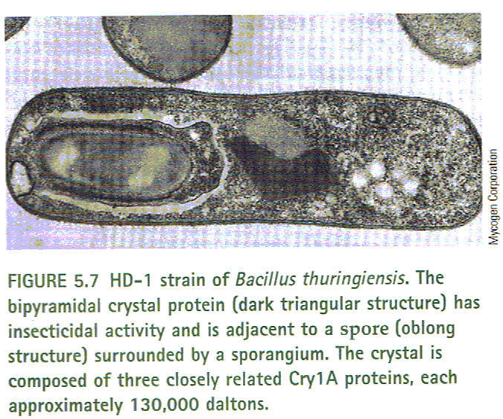
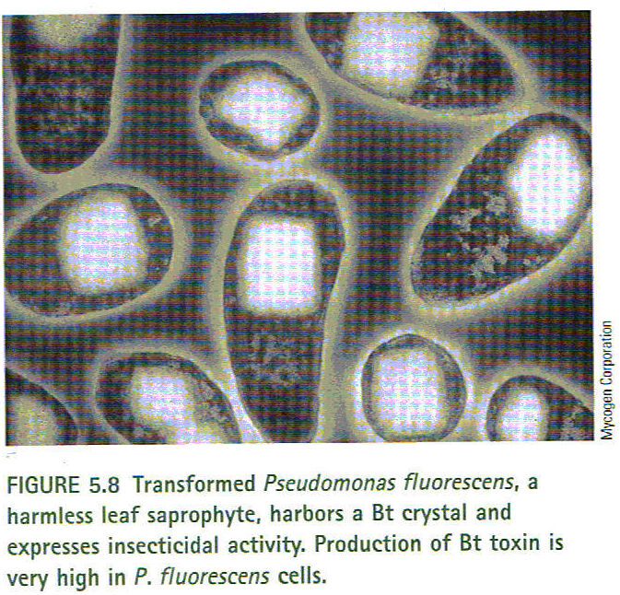

Slide 25
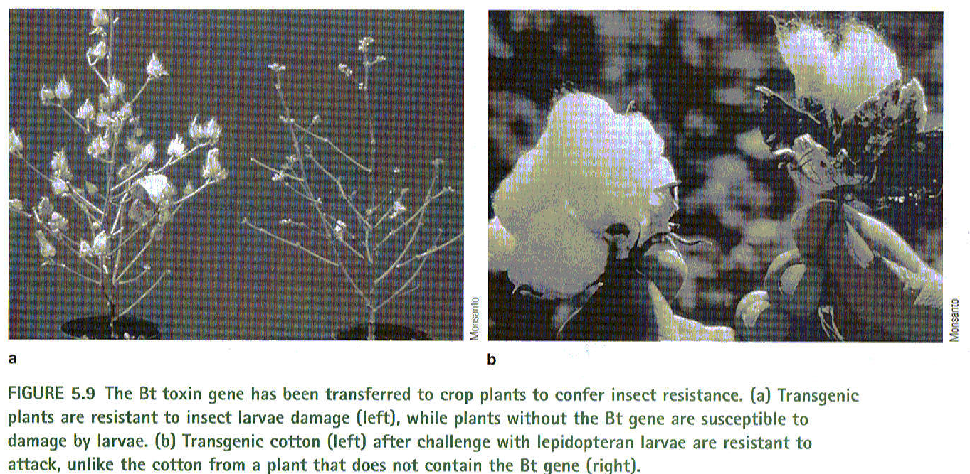

Slide 26
7. Baculoviruses (Fig 5.10)
a) Infect mostly larval stages of insects, which are the most harmful to plants.
b) Very specific to insect, and do not infect other species.
c) The virus DNA enters gut epithelial cells, causing the virus to replicate and eventually infect all of the cells inside of the insect.
d) Engineered viruses may be an alternative to chemicals, but the virus takes up to several days to kill an insect, when the insect can still feed on plants.
e) Possibly transfer other toxin genes to the virus, to enhance virulence and increase virus effectiveness.

Slide 27
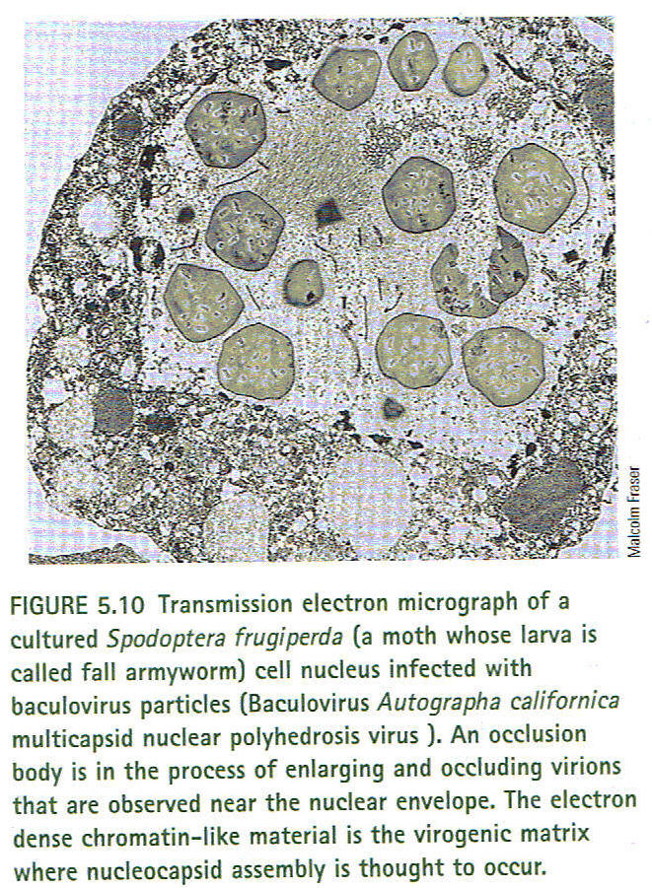

Slide 28
VI. Bioremediation
A. Biodegradation is the natural process where bacteria and fungi can break down hydrocarbons, producing carbon dioxide, water, and inert molecules. Bacteria, cyanobacteria, and filamentous fungi can break down hydrocarbons.
B. Bioremediation is the process of reclaiming or cleaning up contaminated sites using
microorganisms to remove or degrade toxic wastes and pollutants. C. Involves two major methods:
1. The use of nutrients to encourage growth and enhance the activity of bacteria already present in the soil or water. The natural breakdown of hydrocarbons is accelerated by adding fertilizer (and sometimes trace metals and other micronutrients as well as microorganisms), to provide a source of nitrogen and phosphorus that may be in low amounts in the natural environment.
2. The addition of new bacteria to the polluted site. The majority of bioremediation applications use naturally occurring microorganisms to clean up wastes, although genetically engineered microorganisms are being tested. Sometimes by-products resulting from microbial breakdown of wastes can be used for applications such as energy production.

Slide 29
D. Xenobiotics are chemicals such as crude oil, benzene, and PCBs, which can persist in the environment and poison wildlife and humans. Many of these chemicals are in the
environment due to industrial processes and other activities, and the removal of the chemicals is a formidable challenge.

Slide 30
Oil Spills
1. Oil is made of a variety of hydrocarbons, depending on whether it is refined or not.
2. Oil spills can impact wildlife and enter water supplies, and natural biodegradation may take centuries to accomplish.
3. Microorganisms with hydrocarbon-oxidizing enzymes that can attach to hydrocarbons are useful in bioremediation:
a) Adding the bacteria and fertilizers (Figure 5.11) will enhance their activity.
b) Biotechnology may produce bacteria that can more quickly break down oil.

Slide 31
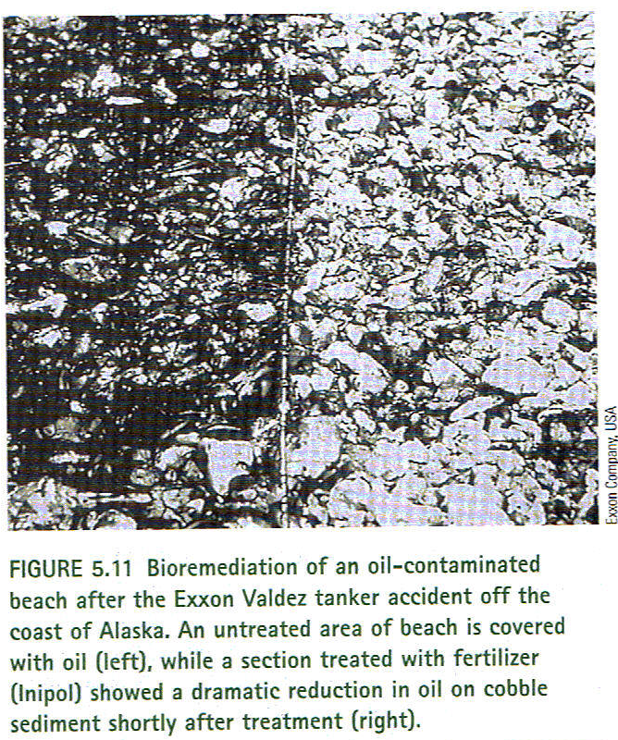

Slide 32
Wastewater Treatment
1. Bacteria are introduced into wastewater in an environment where they can grow, but are sometimes immobilized on plastic films where water flows over them.
2. Soil can be treated by two ways:
a) Pumping contaminated water to the surface before adding nutrients to encourage bacterial action.
b) Percolating water and nutrients into the contaminated soil.
3. Artificially constructed wetlands can be used to treat urban runoff, industrial wastes, and agricultural wastes where plants with microbes adsorb and degrade organic and inorganic wastes.
4. Can also treat water in lagoons or ponds, where the sediment is aerated and bacteria are allowed to grow. Other bacteria can be added if needed.
5. Chemicals such as resins, aromatics, and highly chlorinated hydrocarbons are very difficult to remove, and sometimes they are close to impossible. A potential answer to the problem may be genetically engineered bacteria for bioremediation.

Slide 33
G. Chemical Degradation
1. In the 1960s, bacteria were found to be able to break down pesticides, herbicides, and many other organic chemicals such as halogenated (DDT) and nonhalogenated aromatic compounds (PAHs).
2. Many digestive enzymes are coded for within the bacterial chromosome, some within plasmids.
3. A wide variety of bacteria, fungi, and algae can break down PAHs, such as naphthalene, with the possibility of more through genetic engineering, combining multiple degradative genes, and transferring genes to other microorganisms.
4. First engineered organisms developed in the 1970s, which can break down several compounds in petroleum (Figure 5.12).
5. New toxin-degrading bacterial strains can be created by manipulating genes within an organism’s degradative pathways, such as E. coli that can break down toluene, which are less susceptible to breakdown by chemicals than other species.
6. Possible other developments may include the use of enzymes in controlled environments or in fermenters, and metals can be transported into bacterial cells for breakdown of metals in water, soils, and sludges.

Slide 34
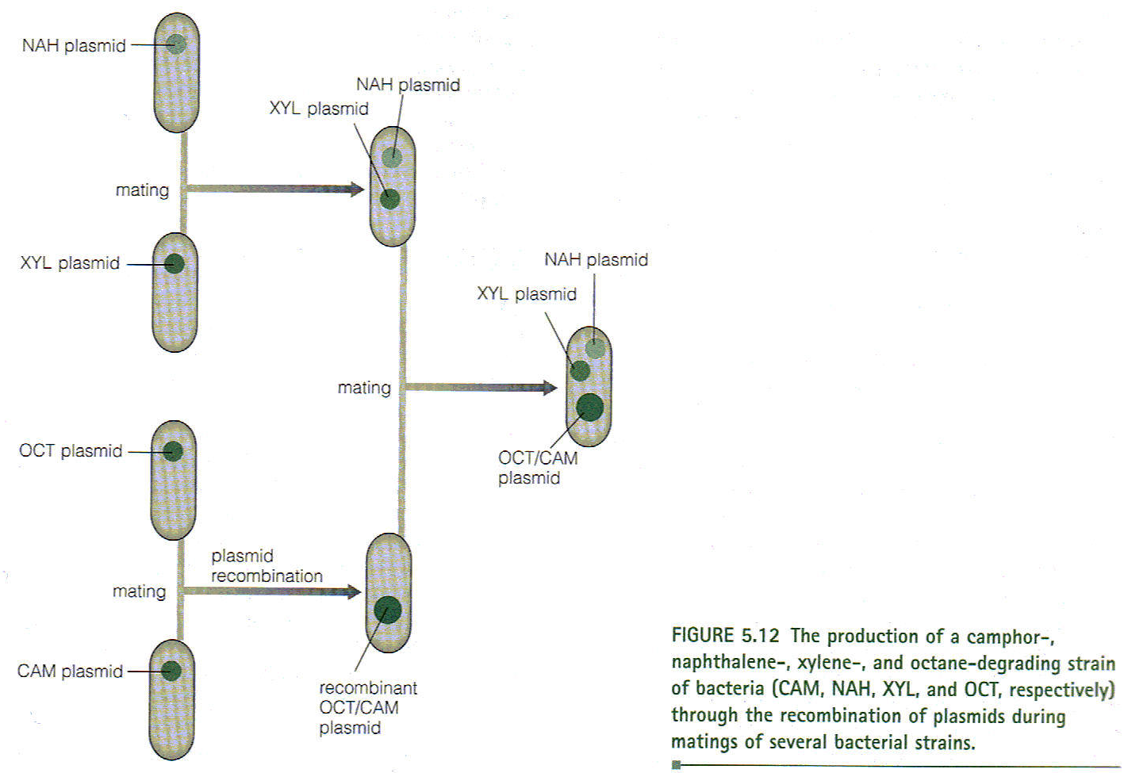

Slide 35
H. Heavy Metals
1. Metals can be toxic and possibly disrupt metabolic reactions, bind to DNA, and increase mutations.
2. Bacteria evolved effective resistance mechanisms, ensuring survival in high metal concentrations, by the following ways:
a) Transporting metal ions outside of the cell.
b) Accumulation of metals in an inaccessible form so they do not cause harm (chelation).
c) Chemical transformation of a toxic compound to a less toxic one.
3. Bacterial genes are being identified that allow bacterial resistance to metals such as cobalt, zinc, copper, and lead.
4. Microorganisms that are genetically engineered to express metal-resistance operons are being studied to see how well they reduce the amount of metal-containing compound in the environment.

Slide 36
VII. Oil and Mineral Recovery
Oil Recovery.
Microbial-enhanced oil recovery (MEOR) may be an economically attractive alternative for oil recovery in several ways:
a) Bacteria are injected into oil reservoirs along with nutrients.
b) Indigenous bacteria are fed nutrients that stimulate oil breakdown.
c) Microbial products such as polysaccharides (example of xanthan gum) are injected to loosen oil that adheres to rock.
d) Anaerobic microbes can produce solvents, such as acetone, that can increase oil mobility and loosen oil on rock.
e) Gases solubilized by anaerobic bacteria allow oil to be more mobile.
2. Potential problems of microbial methods include natural biodegradation of oil, microbial corrosion, and an increase in hydrogen sulfur content in oil caused by anaerobic breakdown of by-products of aerobic reactions.

Slide 37
B. Metal Extraction.
1. Bacteria and fungi can be used to recover metals because negatively charged polysaccharides on cell surfaces trap and concentrate positively charged metal ions.
2. Chemoautotrophic bacteria can be used to oxidize metals such as iron and sulfur, although they also need nutrients such as ammonium, calcium, and oxygen.
3. Thiobacillus ferrooxidans is used routinely to remove copper and uranium from rock. It also can concentrate metals inside of the cell, such as cobalt and zinc.
4. Final products of bacterial oxidation of an ore are the treated solid and a liquid. Each product requires a different extraction method, and all extractions will produce the by-products of sulfuric acid, iron, and either arsenic or cyanide.
5. Engineering bacteria to enhance extraction efficiency, with methods such as bacterial cell adsorption of metals possibly becoming common. This is accomplished in two phases:
a) Electrostatic interactions occur first.
b) Formation of chemical bonds such as sulfur-sulfur bonds occur later.
6. Specific bacteria could be used to obtain various metals or minerals.

Slide 38
Future of Bioremediation.
1. Even though they show much promise, microorganisms are limited by metabolism and habitats, and genetic manipulation may be required to allow them to live in inhospitable conditions.
2. Most future technologies will be in pollution prevention, as well as the reduced use of hazardous chemicals and fossil fuels.

Slide 39
Microorganisms and the Future
Research is focusing on the identification of new strains that may provide new applications that are previously unknown.

